Slide 1
Session 1 – KLC Introduction Data Skills for Research Kellogg Research Support
August 14, 2023
Notes:
Welcome. We are so happy you’re here.
What you are about to hear next is about the closest you will get to a lecture in this workshop series. Most of the rest of this will be pretty interactive.
There will be discussions and you follow along with a demonstration, and maybe try to solve a few problems yourself.
But before we get into demonstrations of tools and how to apply them to your research work, I want to talk a bit about the reproducibility of that work you are about to start.
It is a very important topic, and I believe there are a few general principles that, if kept in mind, can help you quite a lot when you go to reproduce your work in the future.

Slide 2
Common KLC Tasks
Kellogg Computing
Software Modules
Open connections and start sessions
Open a terminal and use the shell
Transfer files to and from KLC
Use a text editor
Use graphical tools for R, Stata, Python
Command line tools for R, Stata, Python
Create Conda environments
Clone and use Git repos for source control
Notes:
Actions to Demonstrate and Explain
Log into KLC using FastX in browser
Navigate directories with cd and ls
Where to store which files?
Make a directory with git clone
Load module
Note software version
Open a file with nano, inspect contents, make a minor change (like update a parameter)
Open a program file using a GUI
R program in rstudio
Stata .do file in xstata-se
Python in a Jupyter notebook
When to use GUI versus headless batch process
Repeat R, Stata programs from command line
Inspect output
Save changes and commit back to GitHub repo

Slide 3
Graphical Programming Tools
Python
VSCode:
Jupyter notebooks:
R
RStudio
Jupyter notebooks
Stata
XStata

Slide 4
Command Line Programming Tools
Python
python <file.py>
python (shell)
R
Rscript
R shell
Stata
stata

Slide 5
Creating a Conda Environment (yaml file)
The basic commands for creating a conda environment only allow you to install one package at a time. A yaml file allows you to install multiple packages while accounting for dependencies between libraries.
Using a text editor, create the following file on KLC called r_env.yml
You can run this file using the mamba module on KLC to create the environment
module load mamba
mamba env create -f r_env.yml
# Create r_env.yml file
# begin r_env.yml
name: r_env
channels:
- r
- conda-forge
dependencies:
- r-base = 4.1.1
- r-data.table
# end r_env.yml

Slide 6
Activating a Conda Environment
To activate the environment in the future, either load mamba:
module load mamba
OR any version of conda:
module load python-anaconda3/2019.10
Then run this line to activate the environment:
source activate sample_r_env
To leave the environment:
source deactivate sample_r_env
To output the yaml file so you can share your environment with others:
conda env export > sample_r_env.yml

Slide 7
Text Editors on KLC
KLC has several text editors available for you to use. The links below provide the basic syntax for other text editors available to you:
Nano: From any terminal session on KLC, type:
nano <file_name>
https://www.redhat.com/sysadmin/getting-started-nano
Emacs: From any terminal session on KLC, type:
emacs <file_name>
https://www.redhat.com/sysadmin/beginners-guide-emacs
Vi: From any terminal session on KLC, type:
vi <file_name>
https://www.redhat.com/sysadmin/introduction-vi-editor
Notes:
One last idea…
To reproduce results implies that you were able to produce them correctly in the first place.
So throughout the workshops, we will try to emphasize the virtue of breaking your problems into smaller pieces
And then testing them relentlessly to convince yourself they are doing what you expect them to do.
Near the end of the series, one of our hours will be dedicated to helping you make your code “bulletproof.”

Slide 8
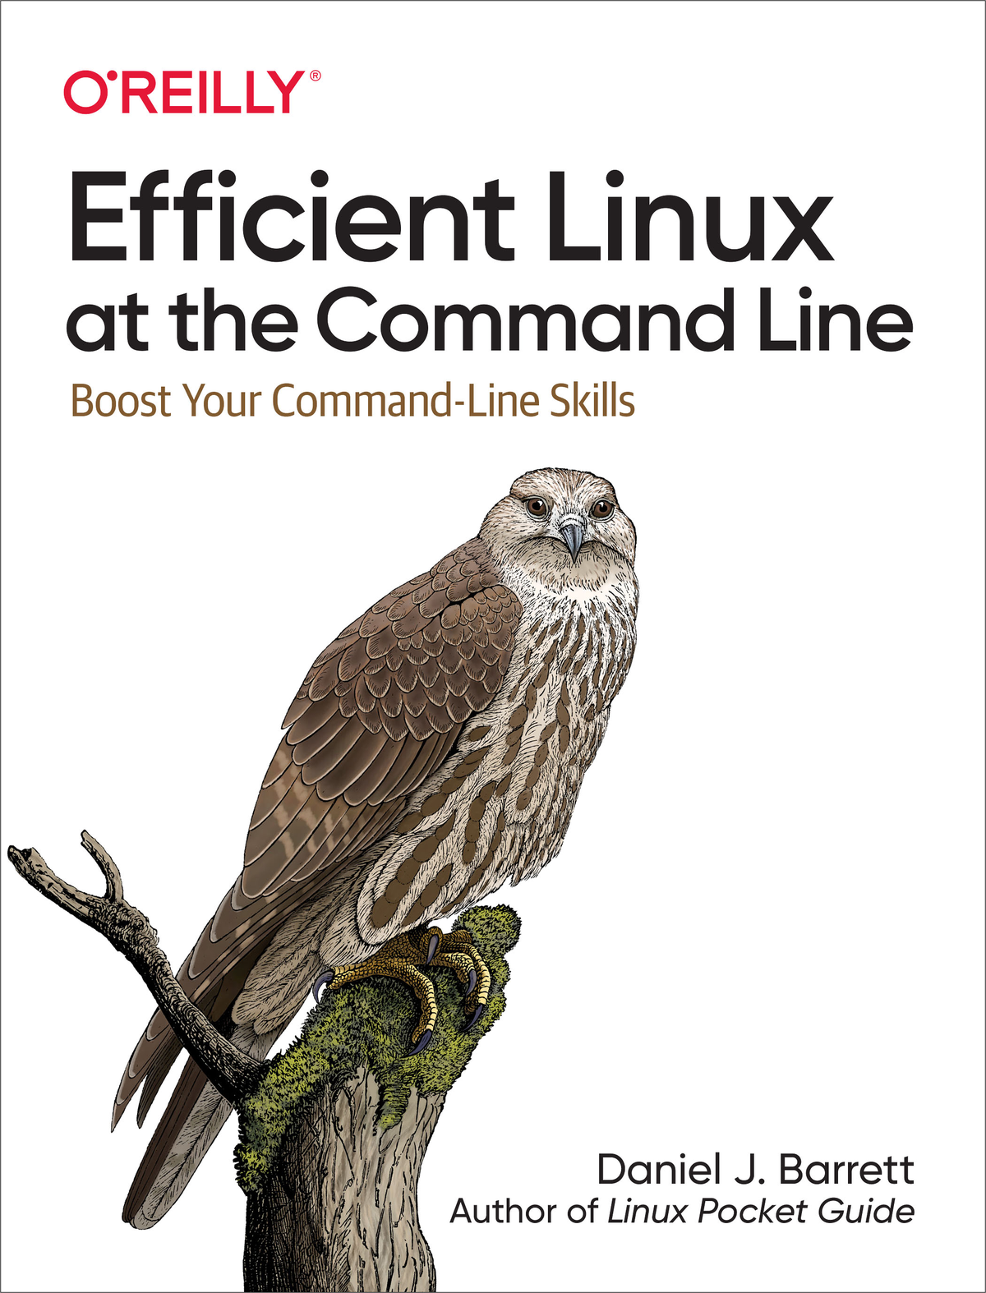
Level Up on the Command Line
https://learning.oreilly.com/library/view/efficient-linux-at/9781098113391/

